Slide 1
Heap Sort
Notes:
1

Slide 2
Heap
Notes:
2

Slide 3
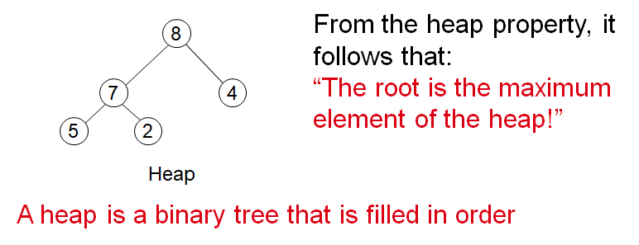
The Heap Data Structure
A heap is a nearly complete binary tree with the following two properties:
Structural Property: all levels are full, except possibly the last one, which is filled from left to right
Order (heap) property: for any node x
Parent (x)>=x

Slide 4
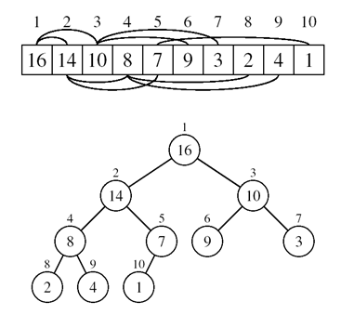
Array Representation of Heaps
A heap can be stored as an array A
Root of tree is A[1]
Left child of A[i] = A[2i]
Right child of A[i] = A[2i + 1]
Parent of A[i] = A[ i/2 ]
Heapsize[A] ≤ length[A]
The elements in the subarray A[(n/2+1) .. n] are leaves

Slide 5
Heap Types
Max-heaps (largest element at root), have the max-heap property:
for all nodes i, excluding the root:
A[PARENT(i)] ≥ A[i]
–
Min-heaps (smallest element at root), have the min-heap property:
for all nodes i, excluding the root:
A[PARENT(i)] ≤ A[i]

Slide 6
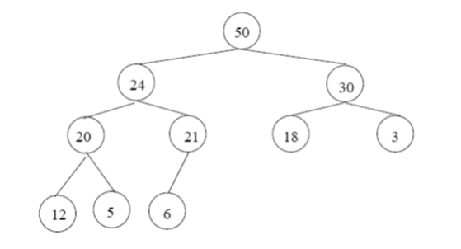
Adding/ Deleting Nodes
New nodes are always inserted at the bottom level (left to right)
Nodes are removed from the bottom level (right to left)

Slide 7
Operations on Heaps
Maintain/ Restore the max-heap property
MAX-heapify
Create a max-heap from an unordered array
Build-MAX-Heap
Sort an array in Place
HEAPSORT
Priority queues

Slide 8
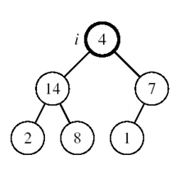
Maintaining the Heap Property
Suppose a node is smaller than a child
Left and Right subtrees of i are max-heaps
To eliminate the violation:
Exchange with larger child
Move down the tree
Continue until node is not smaller than children

Slide 9
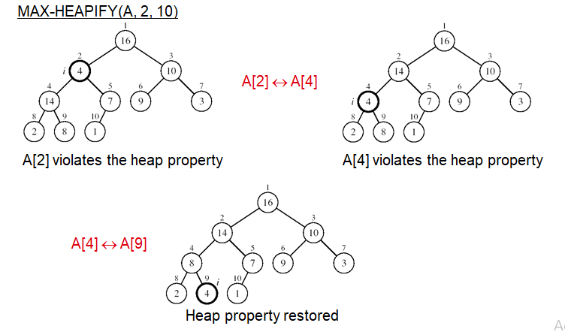
Example

Slide 10
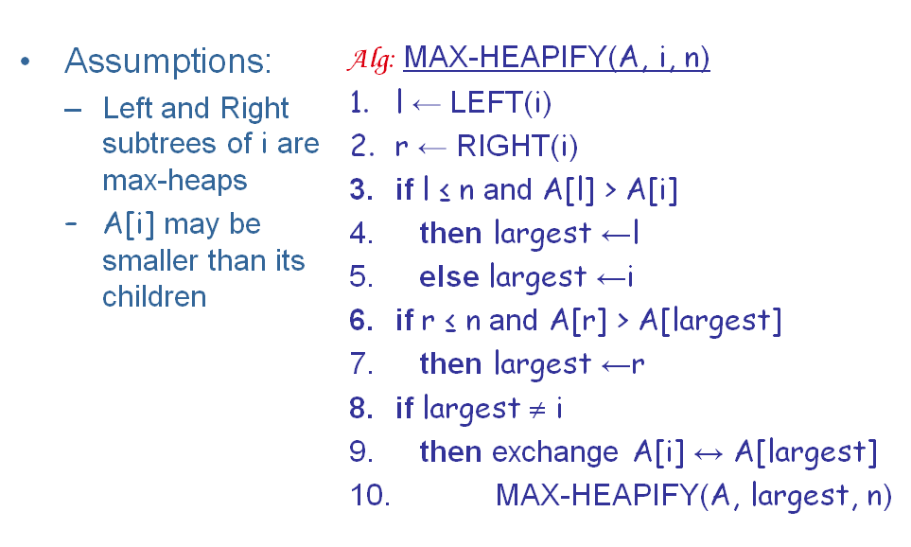
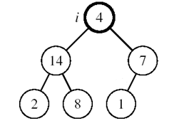
Maintaining the Heap Property

Slide 11
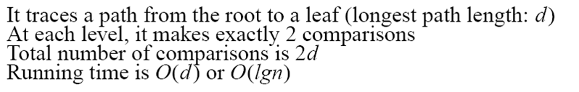
MAX-HEAPIFY Running Time
Intuitively:
Running time of MAX-HEAPIFY is O(lgn)
Can be written in terms of the height of the heap, as being O(h)
Since the height of the heap is lgn

Slide 12
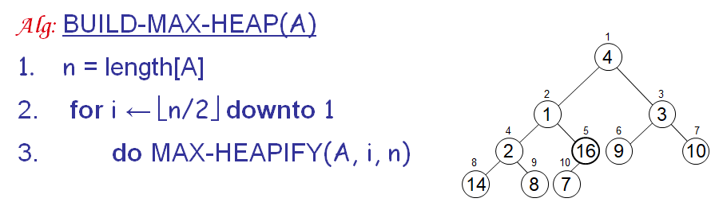

Building a Heap
Convert an array A[1 … n] into a max-heap (n = length[A])
The elements in the subarray A[(n/2+1) .. n] are leaves
Apply MAX-HEAPIFY on elements between 1 and n/2

Slide 13
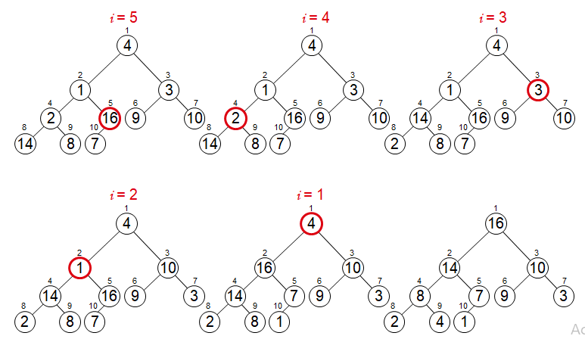
Example

Slide 14
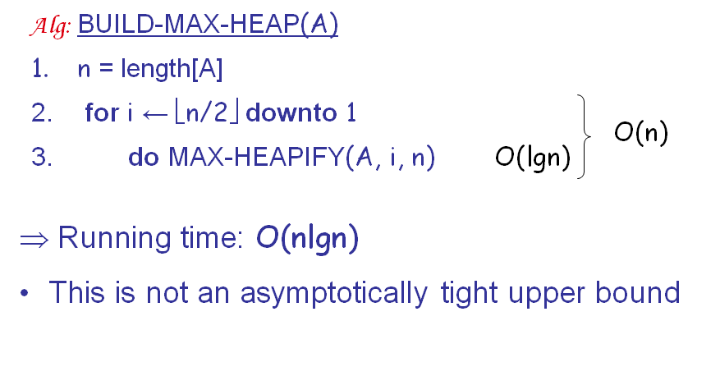
Running Time of BUILD MAX HEAP

Slide 15
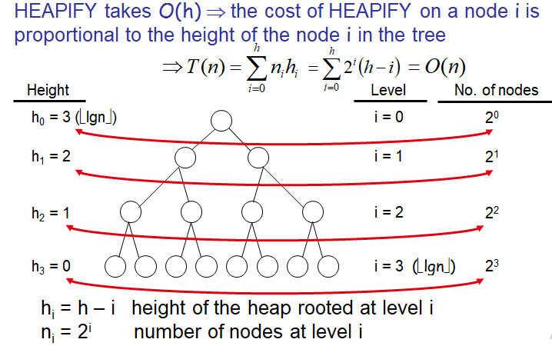
Running Time of BUILD MAX HEAP

Slide 16
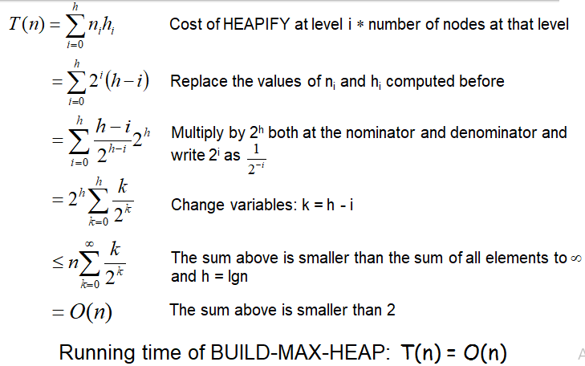
Running Time of BUILD MAX HEAP

Slide 17
Heap Sort
Notes:
17

Slide 18
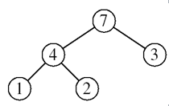
Heapsort
Goal:
sort an array using heap representation
Idea:
Build a max-heap from the array
Swap the root (the maximum element) with the last element in the array
“Discard” this last node by decreasing the heap size
Call MAX-HEAPIFY on the new root
Repeat this process until only one node remains

Slide 19
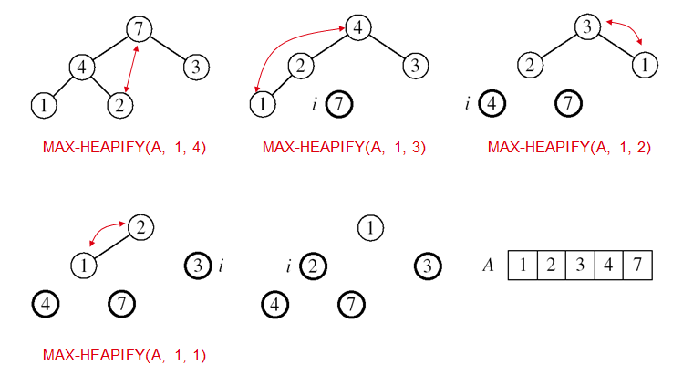
Example: A=[7, 4, 3, 1, 2]

Slide 20
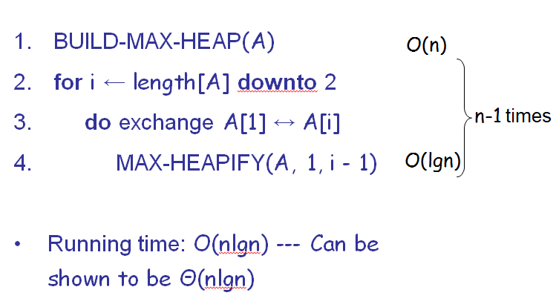
Alg: HEAPSORT(A)

Slide 21
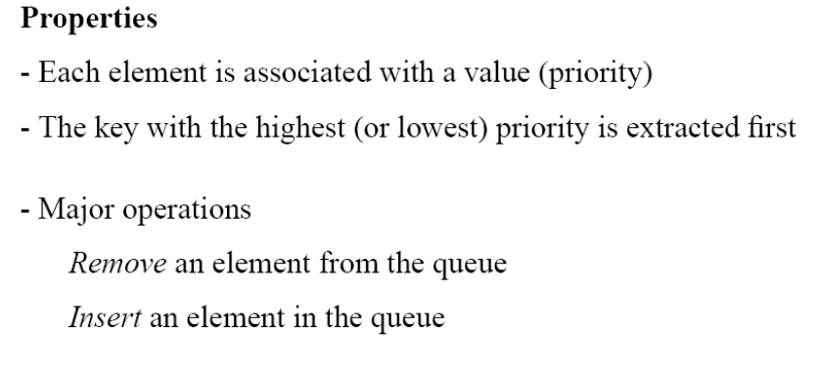
Priority Queues

Slide 22
Operations on Priority Queues
Max-priority queues support the following operations:
INSERT(S, x): inserts element x into set S
EXTRACT-MAX(S): removes and returns element of S with largest key
MAXIMUM(S): returns element of S with largest key
INCREASE-KEY(S, x, k): increases value of element x’s key to k (Assume k ≥ x’s current key value)

Slide 23

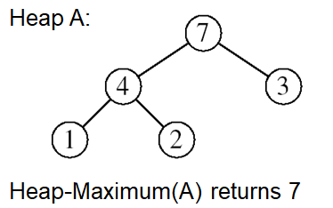
HEAP-MAXIMUM
Goal:
Return the largest element of the heap
Alg: HEAP-MAXIMUM(A)
1. return A[1]

Slide 24
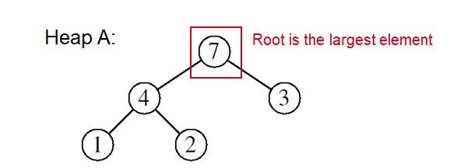
HEAP-EXTRACT-MAX
Goal:
Extract the largest element of the heap (i.e., return the max value and also remove that element from the heap
Idea:
Exchange the root element with the last
Decrease the size of the heap by 1 element
Call MAX-HEAPIFY on the new root, on a heap of size n-1

Slide 25
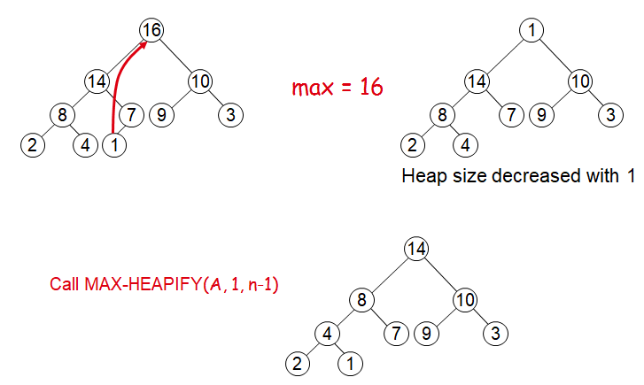
Example: HEAP-EXTRACT-MAX

Slide 26
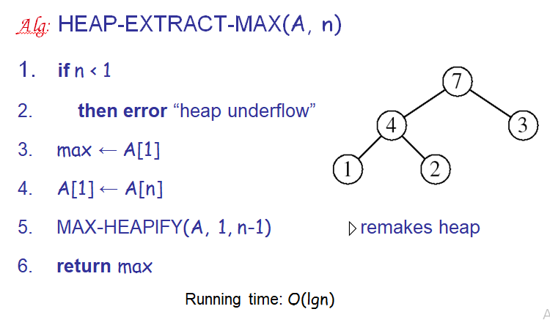
HEAP-EXTRACT-MAX

Slide 27
HEAP-INCREASE-KEY
Goal:
Increases the key of an element i in the heap
Idea:
Increment the key of A[i] to its new value
If the max-heap property does not hold anymore: traverse a path toward the root to find the proper place for the newly increased key

Slide 28
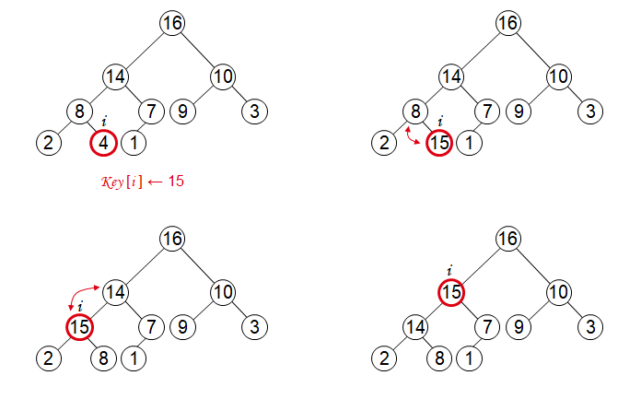
Example: HEAP-INCREASE-KEY

Slide 29
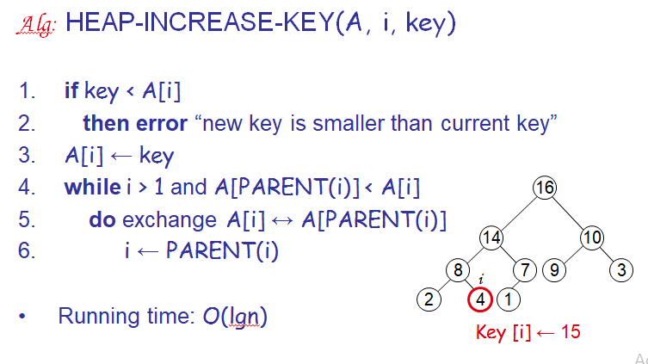
HEAP-INCREASE-KEY

Slide 30
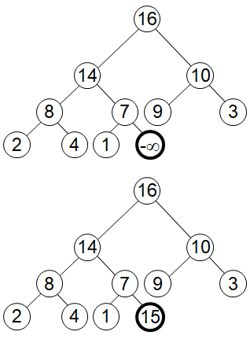
MAX-HEAP-INSERT
Goal:
Inserts a new element into a max-heap
Idea:
Expand the max-heap with a new element whose key is -∞
Calls HEAP-INCREASE-KEY to set the key of the new node to its correct value and maintain the max-heap property

Slide 31
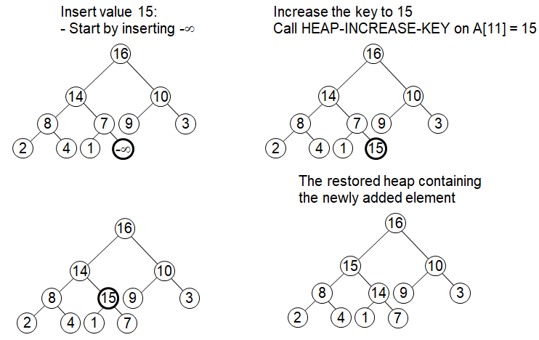
Example: MAX-HEAP-INSERT

Slide 32
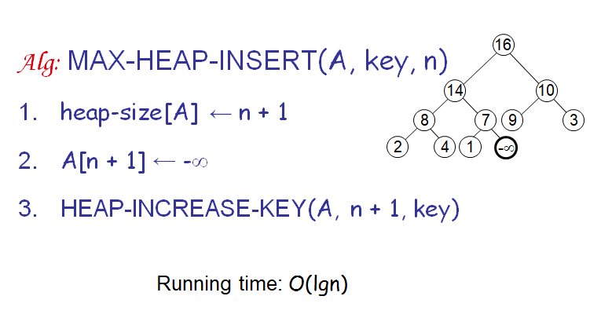
MAX-HEAP-INSERT

Slide 33
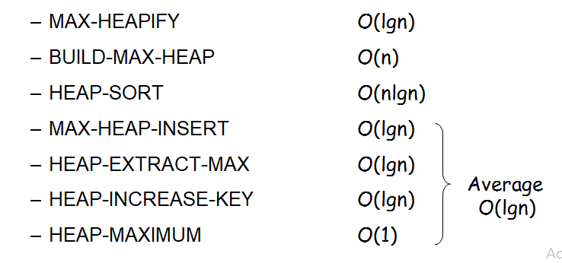
Summary
We can perform the following operations on heaps:

